Slide 1
Arithmetic for Computers
§3.1 Introduction
Operations on integers
Addition and subtraction
Multiplication and division
Dealing with overflow
Floating-point real numbers
Representation and operations

Slide 2
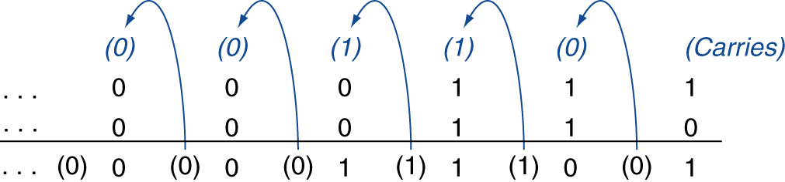
Signed Integer Addition
Example: 7 + 6
§3.2 Addition and Subtraction
Overflow if result out of range
Adding +ve and –ve operands, no overflow
Adding two +ve operands
Overflow if result sign is 1
Adding two –ve operands
Overflow if result sign is 0

Slide 3
Decimal | Unsigned binary | Sign Magnitude | 1's Comp | 2's comp
7 | 111
6 | 110
5 | 101
4 | 100
3 | 011 | 011 | 011 | 011
2 | 010 | 010 | 010 | 010
1 | 001 | 001 | 001 | 001
0 | 000 | 000 | 000 | 000
-0 |  | 100 | 111
-1 |  | 101 | 110 | 111
-2 |  | 110 | 101 | 110
-3 |  | 111 | 100 | 101
-4 |  |  |  | 100
Range | 0 to 7 | -3 to 3 | -3 to 3 | -4 to 3

Slide 4
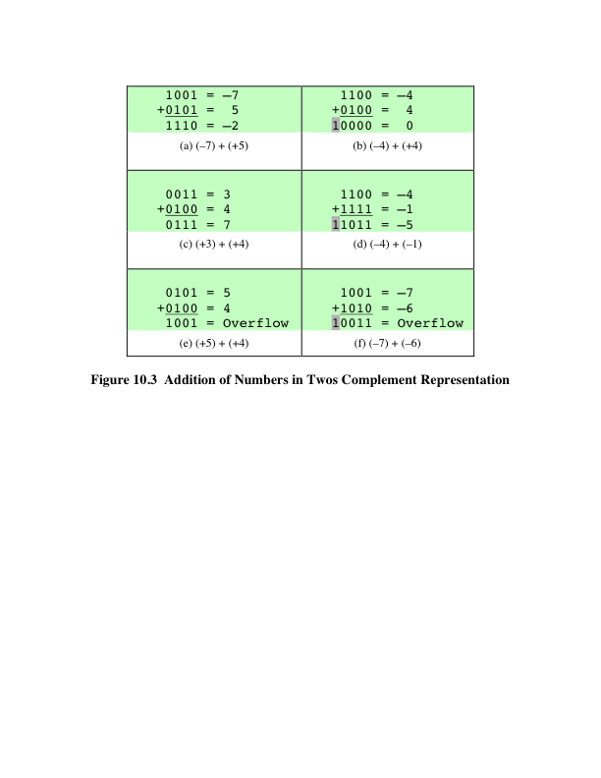
Addition
Notes:
Addition in twos complement is illustrated in Figure 10.3. Addition proceeds as if
the two numbers were unsigned integers. The first four examples illustrate successful
operations. If the result of the operation is positive, we get a positive number
in twos complement form, which is the same as in unsigned-integer form. If the
result of the operation is negative, we get a negative number in twos complement
form. Note that, in some instances, there is a carry bit beyond the end of the word
(indicated by shading), which is ignored.

Slide 5
Signed Integer Subtraction
SUBTRACTION RULE:
To subtract one number (subtrahend) from another (minuend), take the twos complement (negation) of the subtrahend and add it
to the minuend.
Notes:
Subtraction rule.

Slide 6
Integer Subtraction
Add negation of second operand
Example: 7 – 6 = 7 + (–6)
+7: 0000 0000 … 0000 0111 –6: 1111 1111 … 1111 1010 +1: 0000 0000 … 0000 0001
Overflow if result out of range
Subtracting two +ve or two –ve operands, no overflow
Subtracting +ve from –ve operand
Overflow if result sign is 0
Subtracting –ve from +ve operand
Overflow if result sign is 1

Slide 7
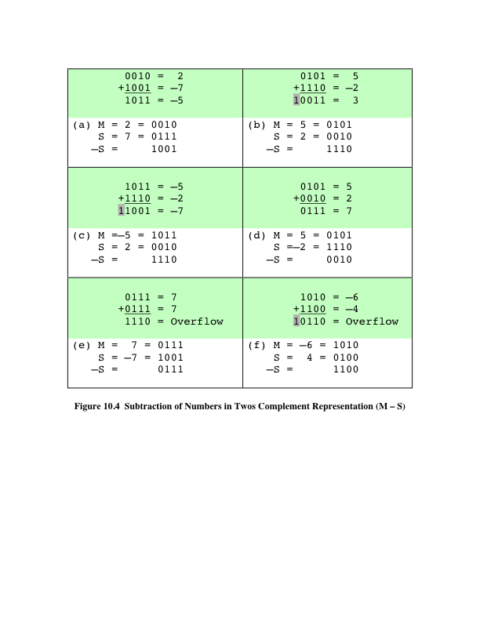
Subtraction
Notes:
Thus, subtraction is achieved using addition, as illustrated in Figure 10.4. The
last two examples demonstrate that the overflow rule still applies.

Slide 8
Dealing with Overflow
Some languages (e.g., C) ignore overflow
Use MIPS addu, addui, subu instructions
Other languages (e.g., Ada, Fortran) require raising an exception
Use MIPS add, addi, sub instructions
On overflow, invoke exception handler
Save PC in exception program counter (EPC) register
Jump to predefined handler address
mfc0 (move from coprocessor 0 reg) instruction can retrieve EPC value, to return after corrective action

Slide 9
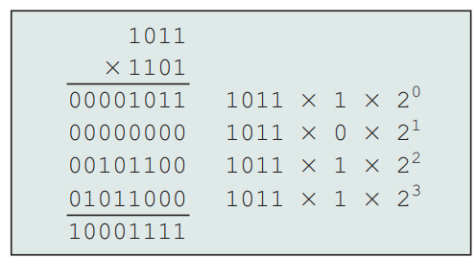
Unsigned Multiplication
§3.3 Multiplication
Paper pencil way
multiplicand
multiplier
product
Length of product is the sum of operand lengths

Slide 10
Multiplication Observations:
Multiplication involves the generation of partial products, one for each digit in the multiplier
The partial products are easily defined:
When the multiplier bit is 0, the partial product is 0
When the multiplier is 1, the partial product is the multiplicand
Each successive partial product is shifted one position to the left relative to the preceding partial product (Effectively shifting multiplicand left one position for every bit of multiplier)
The final product is produced by summing the partial products.
The multiplication of two n-bit binary integers results in a product of up to 2n

Slide 11
Computerizing Multiplication
Can be done more efficiently
A running sum of partial products is maintained rather than waiting until the end to sum all partial products
Saves storage
Shift multiplier right each step
Allows to look at a constant position (i.e) examine the least significant bit only
For each 1 on the LSB of the multiplier
Add (add running sum of partial product with the multiplicand)
Shift (shift left the multiplicand)
For each 0 on the LSB of multiplier
Shift left the multiplicand

Slide 12
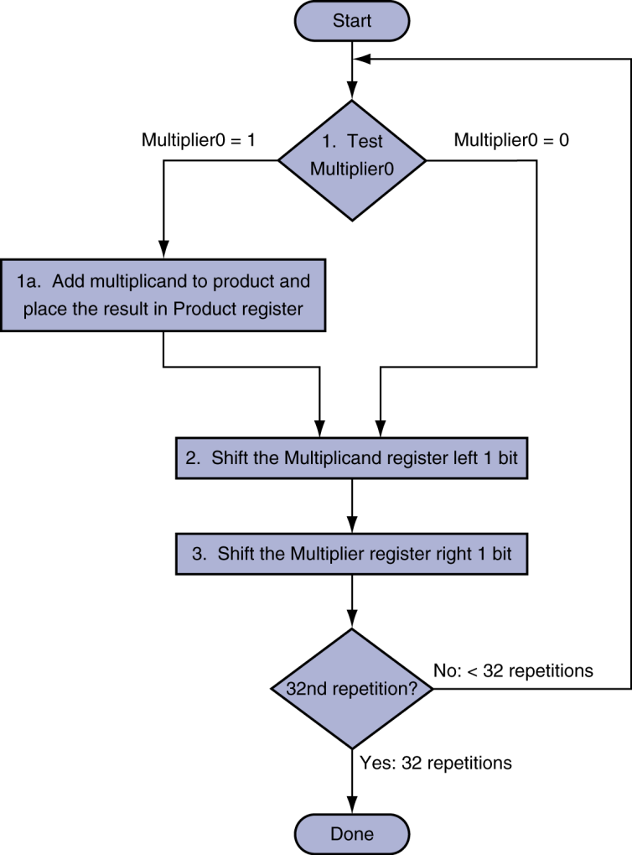
Multiplication Algorithm
Multiplier (Q) n (32) bits
Multiplicand (M) n (32) bits
But we shift Multiplicand n times
So Multiplicand n+n bits
Product (P) 2n bits and initially 0

Slide 13
Unsigned Multiplication example
Action | Product (P) | Multiplicand (M) | Multiplier(Q)
0 | 0 | 0 | 0 | 1 | 0 | 1 | 1
1 | 1 | 0 | 1
Initial
0 | 0 | 0 | 0 | 0 | 0 | 0 | 0
0 | 0 | 0 | 0 | 1 | 0 | 1 | 1
Q[0] = 1:P = P + M
P
SL M, SR Q
0 | 0 | 0 | 0 | 1 | 0 | 1 | 1
0 | 0 | 0 | 1 | 0 | 1 | 1 | 0
0 | 1 | 1 | 0
Q[0] = 0: No op
P
SL M, SR Q
0 | 0 | 0 | 0 | 1 | 0 | 1 | 1
0 | 0 | 1 | 0 | 1 | 1 | 0 | 0
0 | 0 | 1 | 1
0 | 0 | 1 | 0 | 1 | 1 | 0 | 0
Q[0] = 1:P = P + M
P
SL M, SR Q
0 | 0 | 1 | 1 | 0 | 1 | 1 | 1
0 | 1 | 0 | 1 | 1 | 0 | 0 | 0
0 | 0 | 0 | 1
Q[0] = 1:P = P + M |  |  | A
Ans = P
SL M, SR Q
0 | 1 | 0 | 1 | 1 | 0 | 0 | 0
1 | 0 | 0 | 0 | 1 | 1 | 1 | 1
1 | 0 | 1 | 1 | 0 | 0 | 0 | 0
0 | 0 | 0 | 0

Slide 14
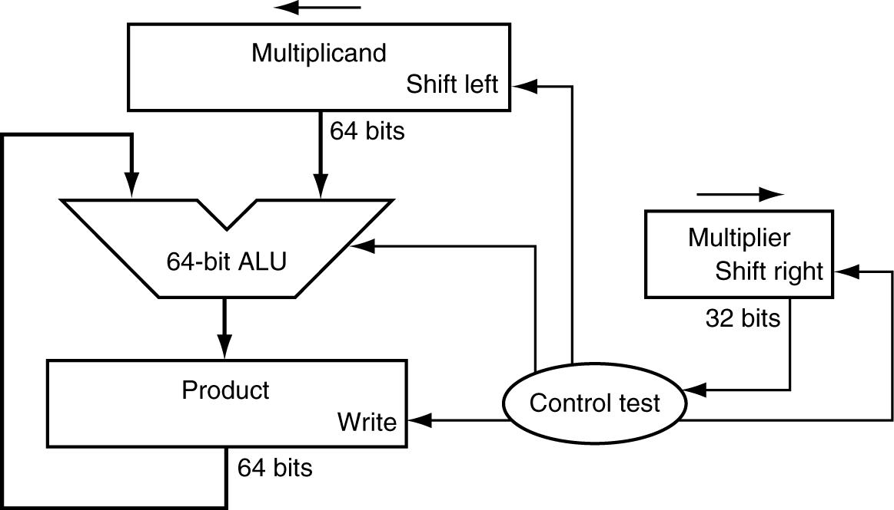
Multiplication Hardware
Initially 0

Slide 15
Booth’s Multiplication algorithm (1951)
Multiplier and multiplicand are placed in the Q and M registers
A 1-bit register (Q₋₁) placed logically to the right of the least significant bit of the Q register
The results of the multiplication will appear in the A and Q registers
A and Q₋₁ are initialized to 0

Slide 16
Booth’s algorithm Working
Control logic scans the bits of the multiplier
each bit is examined along with the bit to its right
Q₀ | Q₋₁ | Action
0 | 0 | Bits of the A,Q, and Q₋₁ registers are shifted to the right 1 bit ( in order to preserve sign bit arithmetic shift right is performed. The leftmost bit of A, A_{n-1} is not only shifted into A_{n-2} but also remains in A_{n-1})
1 | 1 | Bits of the A,Q, and Q₋₁ registers are shifted to the right 1 bit
0 | 1 | A = A + M ; Bits of the A,Q, and Q₋₁ registers are shifted to the right 1 bit
1 | 0 | A = A – M; Bits of the A,Q, and Q₋₁ registers are shifted to the right 1 bit

Slide 17
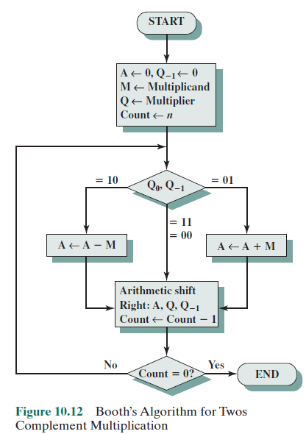
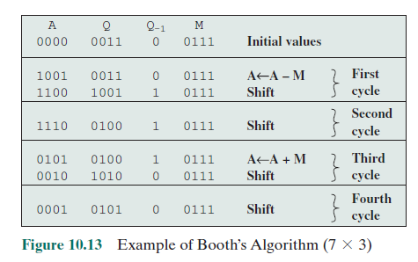
Booth Multiplication algo (1951)

Slide 18
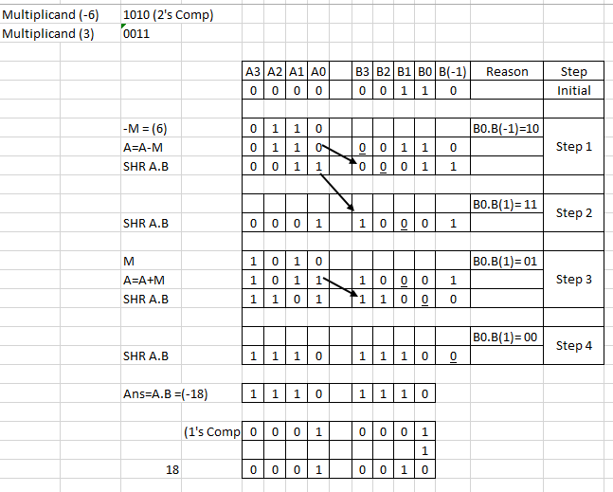
Booth Multiplication algo (1951)

Slide 19
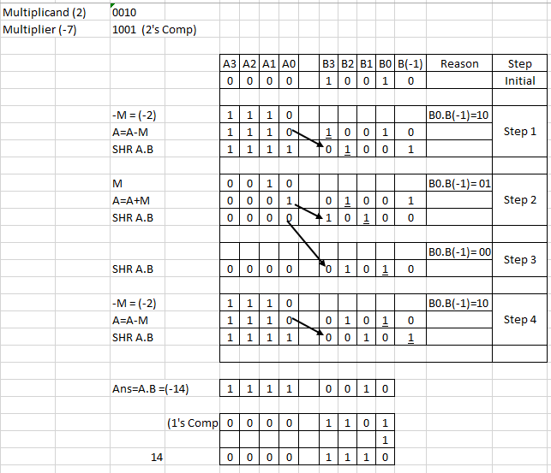
Booth Multiplication algo (1951)

Slide 20
Booth Multiplication algo (1951)
Speeds up the multiplication process
Blocks of 1s or 0s are skipped over, with an average of only one addition or subtraction per block

Slide 21
MIPS Multiplication
Two 32-bit registers for product
HI: most-significant 32 bits
LO: least-significant 32-bits
Instructions
mult rs, rt / multu rs, rt
64-bit product in HI/LO
mfhi rd / mflo rd
Move from HI/LO to rd
mul rd, rs, rt (pseudoinstruction!)
Least-significant 32 bits of product –> rd

